Slide 1
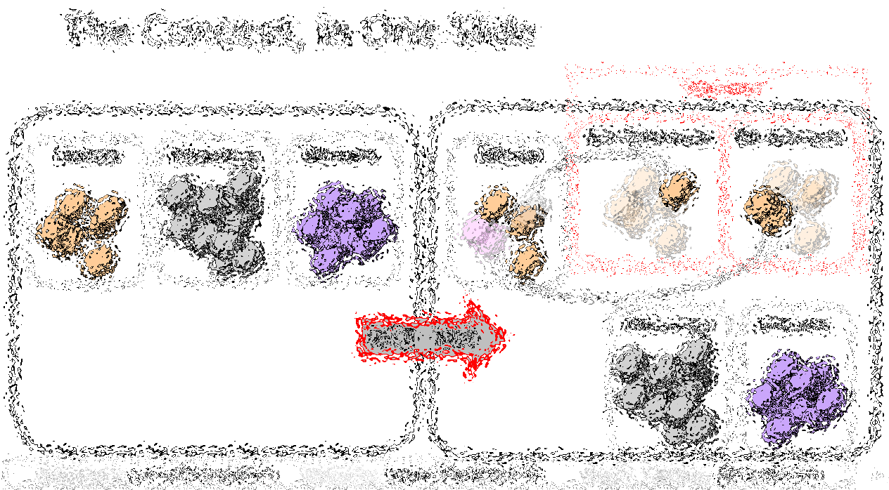

Bip300: Getting to 100% Bitcoin Dominance (and Beyond)
Paul Sztorc
TabConf 2021 -- November 5th
Notes:
TRANSCRIPT OF SPEECH, 11/5/2021: Okay, hello. I’ve been invited to speak about Bip300 ... which is one of my ideas for taking Bitcoin to the next level. ...

Slide 2

The Concept, in One Slide
“Sidechains”
n
n
Bit-Ethereum
Bit-Monero
Bitcoin
Ethereum
Monero
Bitcoin
Bip300
Bip300
BIP 300
Ethereum
Monero
Notes:
Bip300 proposes these new layer2s, that some call “sidechains”. Sidechains are a response to the threat of Altcoins, but they’re also a response to the desire of Bitcoiners for creativity, and innovation – -- you know: the desire to try new things without asking for anyone’s permission. How can we let everyone try the ideas that they like? And how do I keep other people’s bad ideas away from me? So here you see we have the world of Altcoins on the left, but then, the revenge of Bip300 on the right. We have copied Ethereum and Monero into our own projects that respect the 21M coin limit of BTC. No inflation.

Slide 3

The Goal
Smart Contracts DeFi Turing Completeness Ring Signatures zk-Snarks Large Blocksizes
NFTs Oracles
Mimblewimble
…(etc)
Bitcoin does seem great… but can it do _______ ?
Actually we DON’T want Bitcoin to do ______ in the first place because it is actually a bad due to _______, as you can read ______. But if by ______ you really mean ______, then yes Bitcoin can do that! Eventually we are working on _____ which should be able to do ______ even better than ______ anyway but it is actually a good thing that the protocol is so difficult to upgrade beca …
Yes. See BIP 300.
Noob
Bitcoiner
Notes:
Ideally, with Bip300, if some annoying person asks “Sure Bitcoin seems great, but can it do .... smart_contracts, DeFI, zk-snarks, blah blah, you just say “Yes, Bitcoin can do that – see Bip300”.

Slide 4
Fringe Ideas
I can improve Bitcoin! It only needs my new idea: _______ !! When can you merge my code ??
You can’t just merge something into Bitcoin -- It affects everyone else’s nodes!! Besides, ______ has been proposed before and you need to read ______ so that you can learn why everyone hates it, especially our infallible _______ who would have done it by now if it were a good idea. ________ is a SCAM and you are trying to ATTACK BITCOIN!! Even if your idea was good it would probably take years to get consensus and get merged into …
Noob (and/or Fringe Genius)
Use BIP 300.
Good luck!!
Bitcoiner
Notes:
Similarly, if some innovator dreams up a crazy idea, “Hey I can improve Bitcoin, it only needs my new idea ... larger blocksizes, Turing Completeness, KYC-miner-coins?” Then: similarly, they now can do that without anyone’s permission. They just don’t do it on Bitcoin base layer, they do it on a Bip300 sidechain.
So: that’s the goal – FREEDOM. Developers can write whatever code they want, users can use that code if they like. Everyone gets what they want. But how is it accomplished?

Slide 5
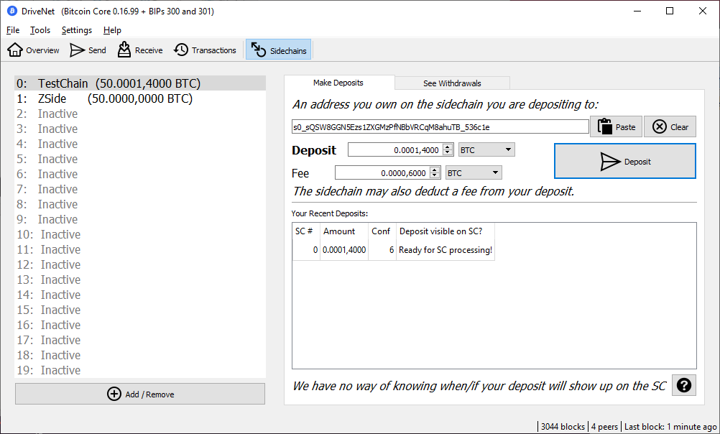
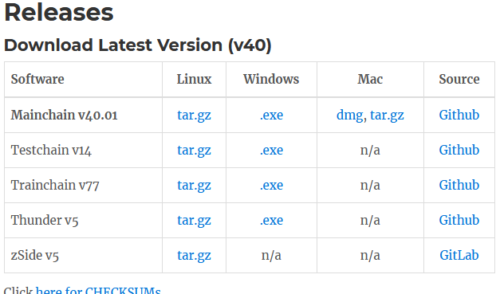
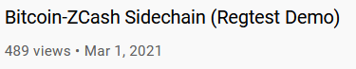
Three Aspects
Not Vaporware
Full Autonomy
Protect Base Layer
Improve Miner Incentives
Notes:
I will break the idea down, into three aspects. These are: Full Autonomy ; Protect the Base Layer ; and Improve Miner Incentives. Before continuing, however, I did want to mention, that this project is not vaporware. The code is open source (on Github, right now!), there’s downloads with a GUI (we have Windows/Mac versions now), and there’s even a YouTube video of me, using Bip300 on testnet, to copy the zCash Altcoin. So the software is very use-able, you can download it right now. Ok now back to these three aspects.

Slide 6
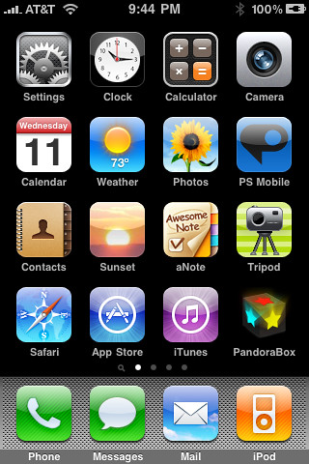
(#1) Full Autonomy
Bip300 Sidechains
zCash (Altcoin)
Bit-zCash
Bit-Monero
Lightning Apps
Strike
Zap
Metaphor
Bitcoin Core
Notes:
Aspect number one: full autonomy. Each new Bip300 sidechain is its own ‘app’ and you can change the sidechain software however you like. It’s just like making a new iPhone app: each “app” has its own development team, the software they write can have any validation rules, (!) or no validation rules. But, for example, they could add: zk-snarks, higher Blocksize, turing complete scripts, Taproot, mimblewimble, Monero ring-signatures, whatever you like. Any idea –good or bad— can be done and no one can stop them. It’s just like releasing a new iPhone app. Each project starts with zero Bit-coins on them. No coins.

Slide 7
(#1) Full Autonomy
Bip300 Sidechains
zCash (Altcoin)
Bit-zCash
Bit-Monero
Lightning Apps
Strike
Zap
Metaphor
Bitcoin Core
Notes:
Coins travel from layer1, to these other networks. Users have to voluntarily choose to send their BTC over. To your software. Just like a lighting App. (So it’s a good comparison). Those purple coins are Altcoins ... we don’t like those. But next to it is a sidechain that does the exact same thing. So....

Slide 8
(#1) Full Autonomy
Bip300 Sidechains
zCash (Altcoin)
Bit-zCash
Bit-Monero
Lightning Apps
Strike
Zap
Metaphor
Bitcoin Core
Notes:
here you see the coins move over. Two coins to Zap, in the lightning world; and one coin to Bit-ZCash, in the Bip300 world. Still 21 million coins total.

Slide 9
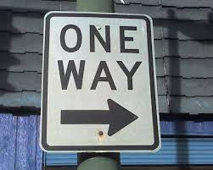
(#2) Base Layer is Safe
Bip300 Sidechains
Bit-zCash
Bit-Monero
Drama
Centralization
Reorgs
Bad Design
Base Layer
Bitcoin Core
Notes:
Ok, aspect two – the base layer ( ie, Bitcoin Core, ie the mainchain, ie “layer1”) that – your Bitcoin node -- is unaffected by problems on the sidechain. Even under very extreme adversarial conditions where the sidechain experiencing all sorts of chaos, Layer1 is just going to solider on, and ignore all of that. The drama can only go one way. So, let me try to explain this.

Slide 10
(#2) Base Layer is Safe
= Block Header
= List of transactions
December 2020
January 2021
February 2021
March 2021
April 2021
Base Layer (Bitcoin Core)
Notes:
Here is a representation of Bitcoin’s blockchain. The squares are block headers, and the trailing rectangles are the list of transactions in each block. (Because blocks aren’t always the same size, of course.) And time is flowing from left to right. You can see across the top I’m going from Dec to April. Normally, of course, there would be tens of thousands of blocks (from Dec to April), that wouldn’t have FIT on the slides so there’s only seventeen. Now, what if there was a sidechain, activated, this whole time? Like a clone of Monero, or something. Well, we’ll put it up...

Slide 11
(#2) Base Layer is Safe
= Block Header
= List of transactions
December 2020
January 2021
February 2021
March 2021
April 2021
Layer 2 (Bit-Monero)
Base Layer (Bitcoin Core)
Notes:
Here it is. It has its own blocks, and its own block headers, and its own block chain, from December (on the left) to April (on the right). Now, the idea is ... that ...

Slide 12
(#2) Base Layer is Safe
= Block Header
= List of transactions
December 2020
January 2021
February 2021
March 2021
April 2021
Layer 2 (Bit-Monero)
e320
81cd
3 Months = One 32-byte Hash
3 Months = One 32-byte Hash
e320b6c2fffc8d750423db8b1eb942ae710e951ed797f7affc8892b0f1fc122b
81cd02ab7e569e8bcd9317e2fe99f2de44d49ab2b8851ba4a308000000000000
Base Layer (Bitcoin Core)
e320 ... Pays Out
Notes:
... Three months of sidechain activity are compressed into one little 64-character string here. And that string is the only thing inserted into Layer1. Ever. So, no matter what Bit-Monero over here is doing, this is all that layer1 will see.. ready ?

Slide 13
Your Layer 1 Node Sees…
(#2) Base Layer is Safe
Base Layer (Bitcoin Core)
e320b6c2fffc8d750423db8b1eb942ae710e951ed797f7affc8892b0f1fc122b
e320 ... Pays Out
81cd02ab7e569e8bcd9317e2fe99f2de44d49ab2b8851ba4a308000000000000
Notes:
This. Therefore, full nodes (on Layer1, down here in blue); they do not check anything that is happening on the sidechain (where there can be, theoretically, unlimited complexity). The sidechain doesn’t need to be a blockchain, it doesn’t need to be written in c++, it can make all kinds of mistakes. Etc. Bip300 operates entirely off of this one little string (here in green). (!) It does a lot of logic to that 4 little string, and assumptions and engineering, game theory economics, etc. I don’t have time to explain all of it. But the point is that Layer1 can’t be harmed by Layer2 because it really is ignoring Layer2. I feel compelled to drive this point even further, so...

Slide 14
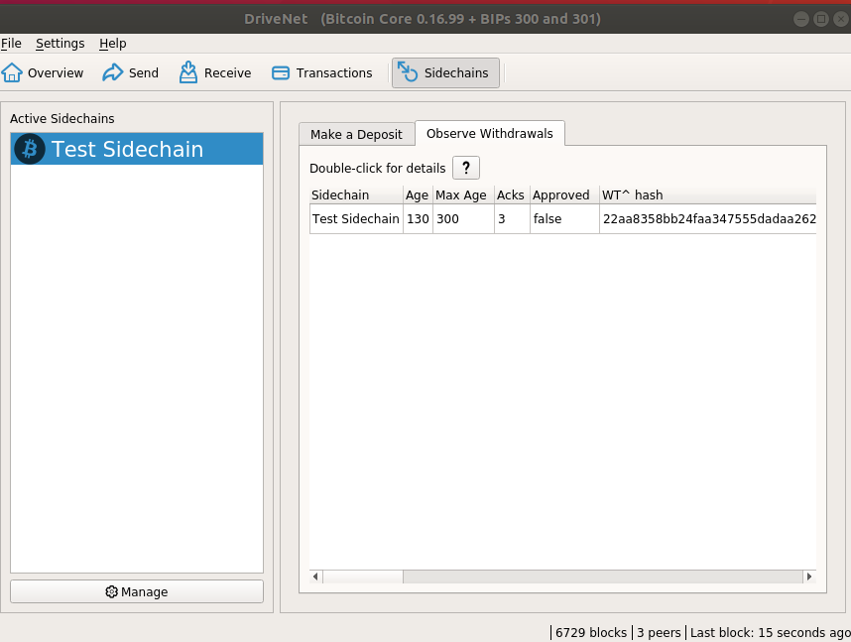
Your Layer 1 Node Sees…
(#2) Base Layer is Safe
Base Layer (Bitcoin Core)
e320b6c2fffc8d750423db8b1eb942ae710e951ed797f7affc8892b0f1fc122b
e320 ... Pays Out
81cd02ab7e569e8bcd9317e2fe99f2de44d49ab2b8851ba4a308000000000000
Notes:
Here is our software. –Just two more slides to finish this point, with a real-world example-- We are looking all the Bip300 withdrawals, there’s only one right now. Which is this little row here.

Slide 15
Your Layer 1 Node Sees…
(#2) Base Layer is Safe
Software will look for a sidechain node, on your computer, (to ask it questions). But if it can’t find one it will report back nothing.
Hash we mentioned before
Base Layer (Bitcoin Core)
e320b6c2fffc8d750423db8b1eb942ae710e951ed797f7affc8892b0f1fc122b
e320 ... Pays Out
81cd02ab7e569e8bcd9317e2fe99f2de44d49ab2b8851ba4a308000000000000
Notes:
Now, the software says “double-click for details”, up here. But for the purposes of this talk, that is misleading. Because what the “double-click” does, is try to find a sidechain node on your computer, with rpc-access, so that it can ask questions about the withdrawal. But if you don’t have a sidechain full node (on this computer), then if you “double-click” it will just tell you that it knows absolutely nothing whatsoever. So, this little row here, is the entire Bip300 idea.

Slide 16
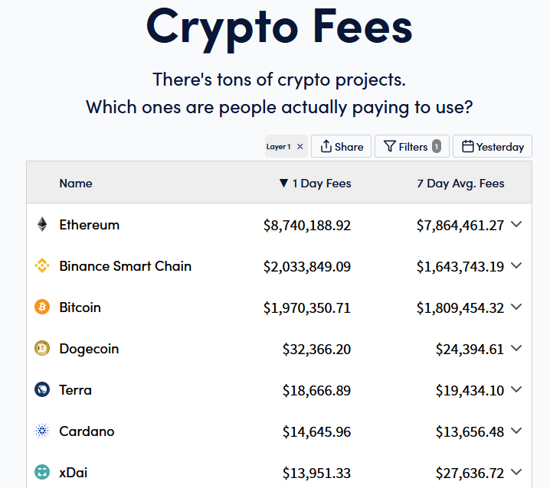
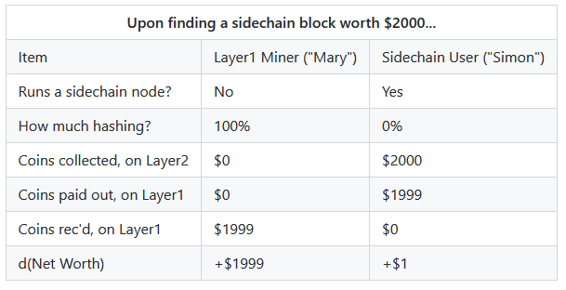
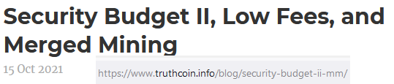
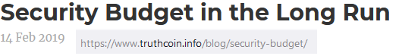
(#3) Improve Mining Incentives (Bip 301)
Get all of the fees, on all of the chains!
Miners can ignore Sidechain / Altcoin software.
Taken from https://cryptofees.info/ this morning.
June 4, 2021
Notes:
Okay third aspect. This one is only this one slide here. Third aspect is that we want to improve Mining Incentives (Bip301). This is technically Bip301, now. I separated the two BIPs, to make them easier to read. But I think anyone with a brain who uses Bip300, would use Bip301 also – but you don’t have to. Anyway, with Blind Merged Mining (BIP 301), miners don’t need to pay attention to Sidechains, at all. So, layer1 users already weren’t paying attention, now layer1 miners can also ignore Sidechains (if they want). They still collect all of the transaction fee-revenues from the sidechain’s txn! How? Well, they contract with someone else who is running a sidechain full node, and the miner sells them the block- rights, basically.

Slide 17
(#3) Improve Mining Incentives (Bip 301)
Get all of the fees, on all of the chains!
Miners can ignore Sidechain / Altcoin software.
Taken from https://cryptofees.info/ this morning.
June 4, 2021
Notes:
Here’s the important part – Miners don’t run a sidechain node, but they still get all the money. Therefore, if miners just do what they normally do, today, and include the txns which pay the highest total fees, then they will automatically mine all sidechain blocks and collect revenue from all the 5 sidechain transactions. Ultimately, I think this concept could boost fee-revenues by 1000x, if not much more. But I don’t have time to tell you about it -- I did write two articles about “Security Budget” that you can look up if you want. Something I want to mention, is that I gave this talk at Bitcoin2021 in June, using these little numbers over here; (on the right). And yesterday I updated the slide…

Slide 18
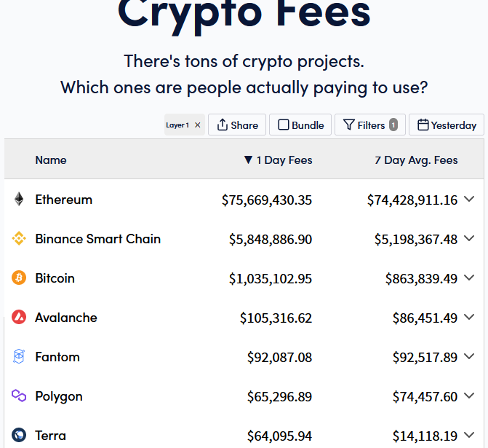
(#3) Improve Mining Incentives (Bip 301)
Get all of the fees, on all of the chains!
Miners can ignore Sidechain / Altcoin software.
+846%
+216%
-52%
Taken from https://cryptofees.info/ this morning.
November 4, 2021
June 4, 2021
Notes:
Bitcoin revenues are down, ETH revenues are way up. Maybe that was unlucky timing, *shrug*. Just something to think about.

Slide 19
Outline
Title / Summary (2)
Bip300 -- Goal, Three Aspects (16)
Outline (1) -- YOU ARE HERE
Altcoins We Should Copy (15)
The Supposed “Drawbacks” of Bip300 (2)
Ending (1)
Notes:
Ok, here’s the rest of the talk. We already made it more than halfway thought. Now I’m going to talk about the Altcoins we should copy. Then I will discuss two supposed Drawbacks of Bip300. And then it’ll be over.

Slide 20

What do we use BIP 300 for…?
(In other words: Which altcoins are worth copying?)
Art: “When I paint my masterpiece” – Nick Kenrick (?) - Creative commons license
Notes:
Ok, so we covered the idea. Now, the concrete use-cases. Here are some Altcoins that I think we should consider ripping-off

Slide 21
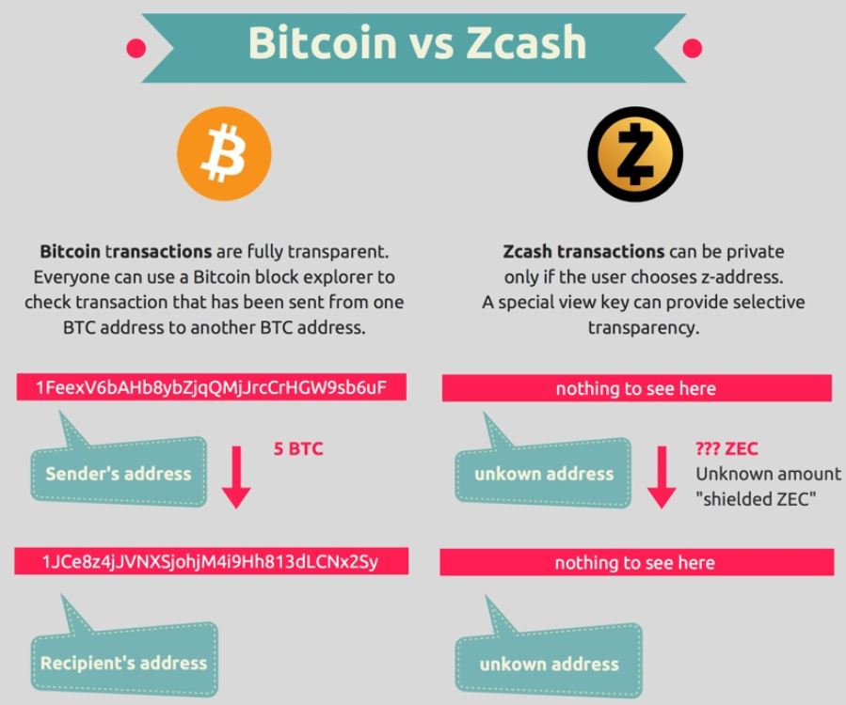
Altcoins we should copy (?): zCash
Image from blockchainhub.net : https://blockchainhub.net/blog/infographics/zcash-explained/
Notes:
Obviously, zCash I mentioned at the beginning. ZCash has transactions where the sender, receiver, and the amount are all private. So then we Bitcoiners have to put up with comparisons like this. Where someone puts something up and says “Bitcoin vs Zcash”. If we had Bip300, this infographic wouldn’t make any sense at all. In fact all debates about one coin vs another coin would make no sense at all. Which brings me to my related point...

Slide 22
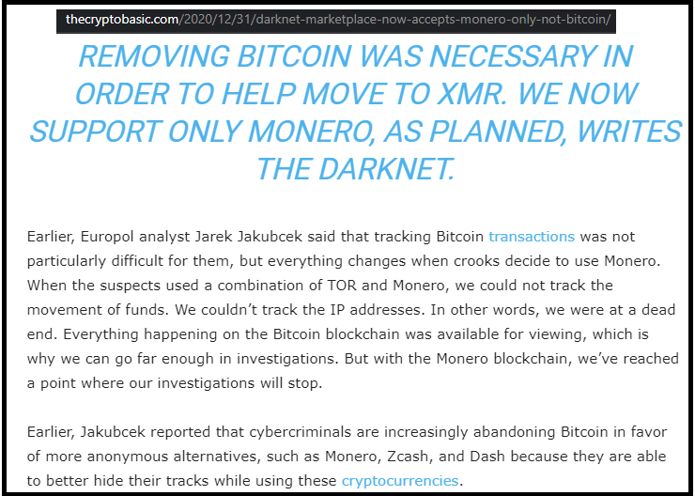
Losing Customers to Monero (?)
Lame!
“White House Market” Retired (not exit scam) on Oct 4, 2021 [last month]
Notes:
...there is a darknet market that, in Dec of last year, decided to only accept Monero. So that’s kind of a slap to the face. If we had Bip300, then there would be no reason for them to accept Monero at all, let alone exclusively.

Slide 23
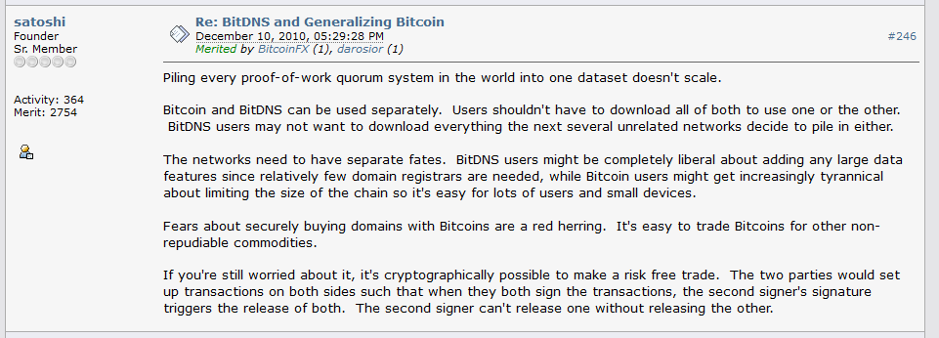
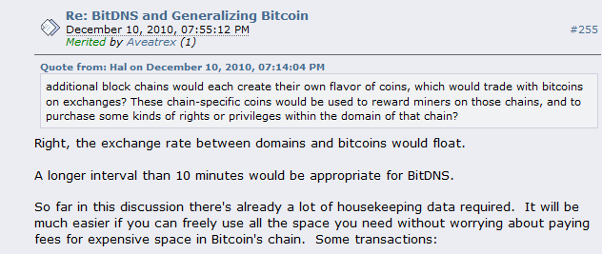
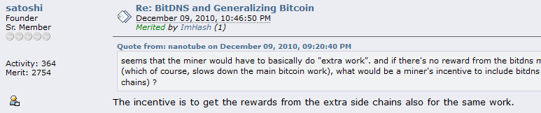
Altcoins we should copy (?): NameCoin
Fun facts -- in this thread, Satoshi: * Invents what is now known as Merged Mining. * Assumes that there will be many separate blockchains that pay different fees (as if this were non-controversial!).
* The term “side chain” is used numerous times!
Notes:
BitDNS was an idea proposed on bitcointalk, which later became the Altcoin Namecoin. This thread -where it’s proposed- is something that absolutely everyone should look up and read, if they have the time. Lots of cool history here. ... Satoshi invents Merged Mining, he coins the term “side chain”, he writes about how there will be lots of different chains, all back in 2010. It’s really cool. Anyway, this concept, “BitDNS” is a weird idea, but I think it has tremendous potential. Again, I don’t have enough time to talk about it. But I did write a big article…

Slide 24
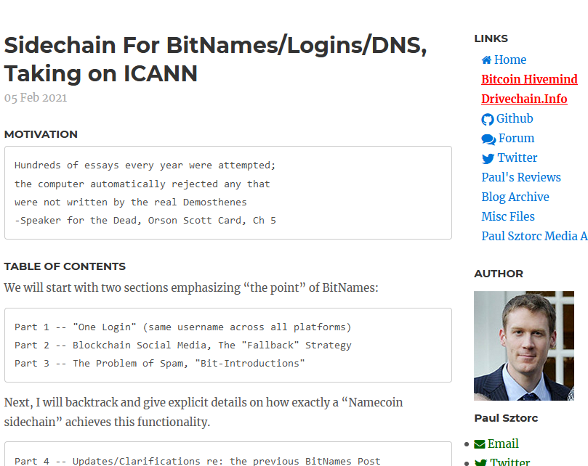
Altcoins we should copy (?): NameCoin
Screenshot #0 from www.truthcoin.info/blog/bitnames/
Notes:
…in Feburary –“BitNames, there’s the url”, and I will now give you a FEW of the images from that article. And you can read the article if you are interested.

Slide 25
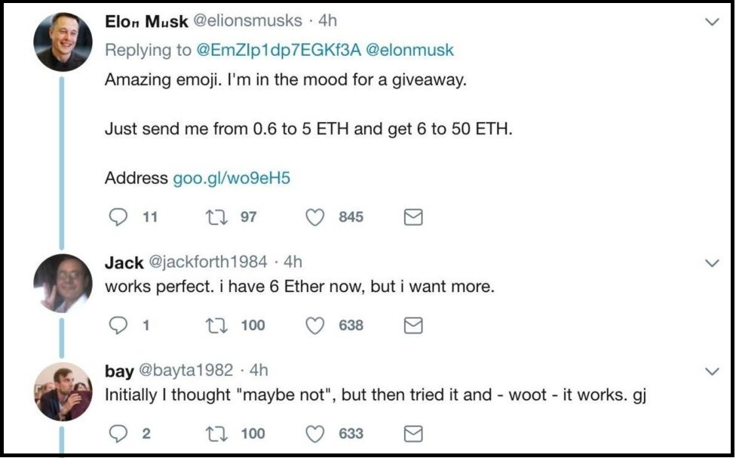
Screenshot #1 from www.truthcoin.info/blog/bitnames/
Altcoins we should copy (?): NameCoin
Notes:
…this is someone pretending to be Elon Musk, on Twitter…

Slide 26
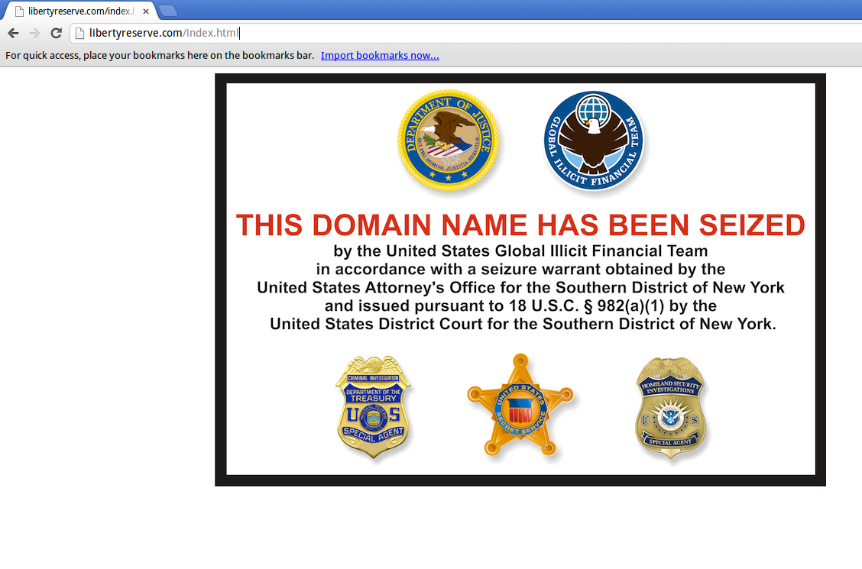
Screenshot #2 from www.truthcoin.info/blog/bitnames/
Altcoins we should copy (?): NameCoin
Notes:
…this is the Liberty Reserve website domain_name being seized…

Slide 27
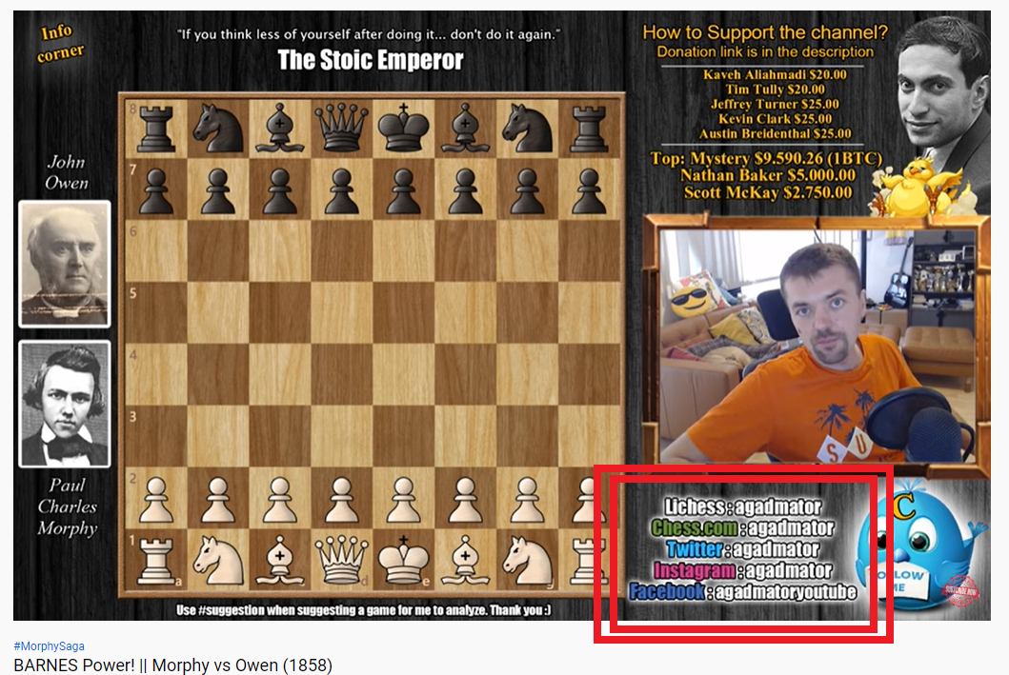
Screenshot #3 from www.truthcoin.info/blog/bitnames/
Altcoins we should copy (?): NameCoin
Notes:
…this is a guy on YouTube who, in the bottom-right, has to list out all of his screennames ... and they aren’t all identical, his Facebook name is different. With BitDNS everyone would just have one login, for every service. No one could seize your account, anywhere. And people would always be able to find you.

Slide 28
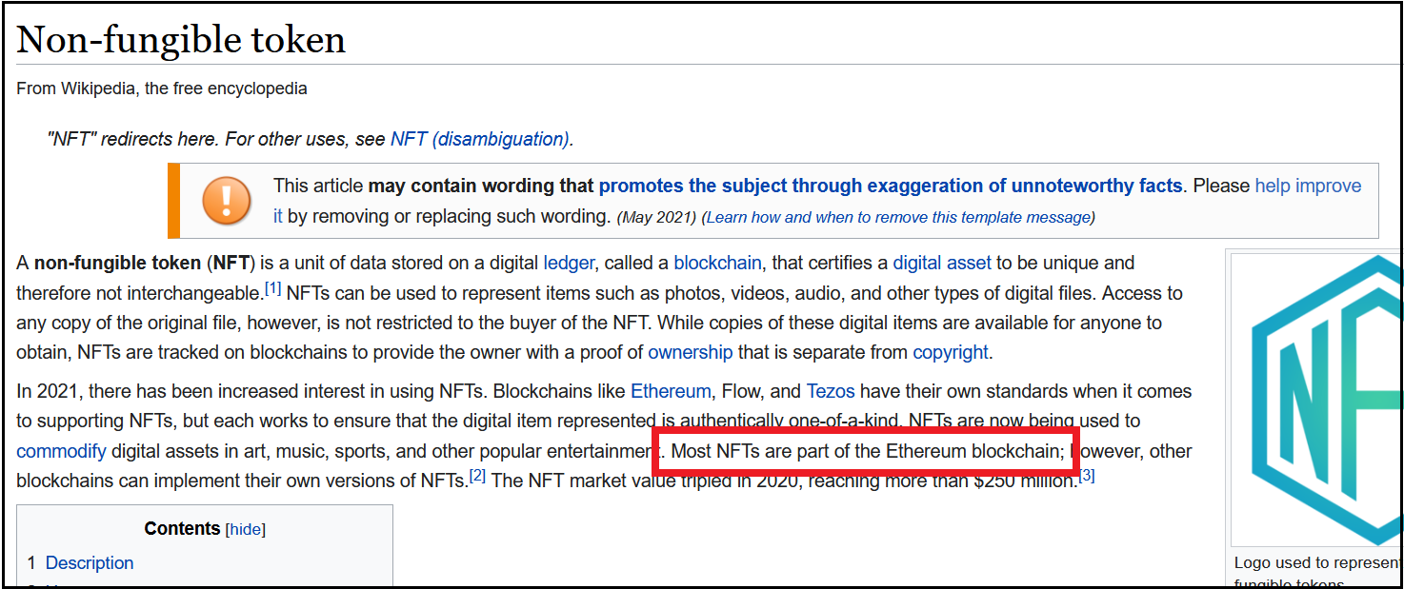
Altcoins we should copy (?): XCP / BitAssets / ERC20
Screenshots NFT craze, Cap table, Outstanding Bonds
So lame!!
Notes:
Ok lets talk about digital assets, now. Erc20/NFTs. They’re basically digital baseball cards. Except they are unforgeable and indestructible, and unseizable. Anyways, a lot of people have fun collecting things. Most NFTs are on Ethereum, which is really lame. Because we Bitcoiners started all that, with counterparty and colored coins, etc. If we had Bip300, we could have a whole, special ERC20 chain or something. That would domesticate all of this energy in Bitcoin. Instead of having it compete against Bitcoin.

Slide 29
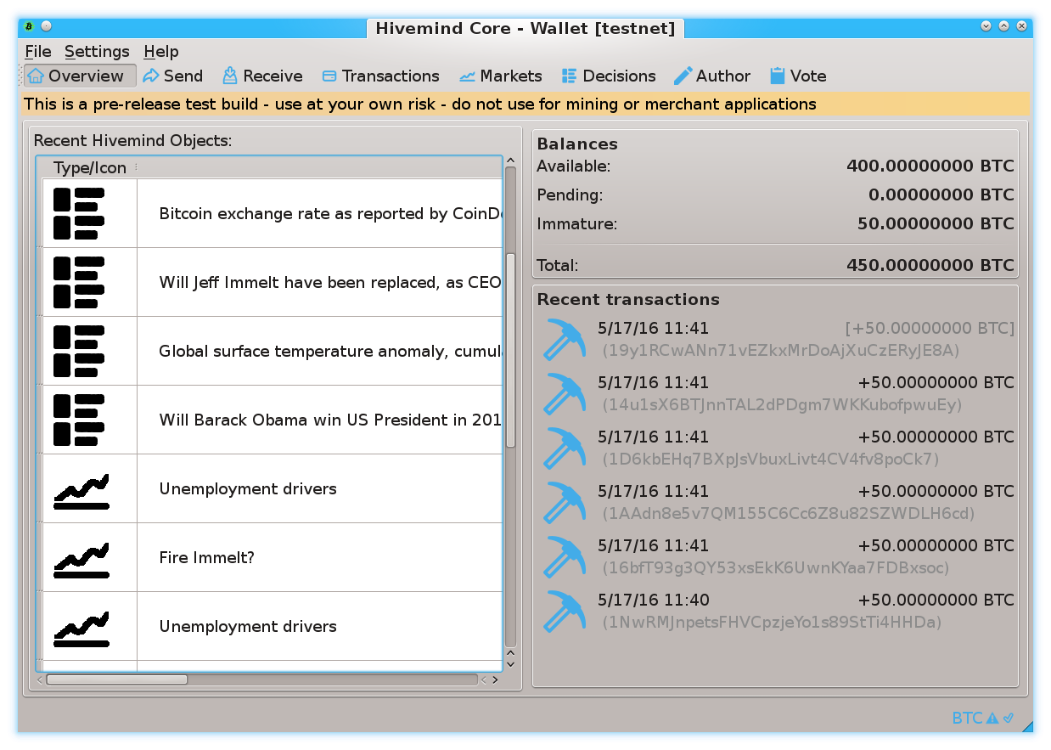
Prediction Markets
Screenshots from my own BTC sidechain project
www.BitcoinHivemind.com
Notes:
This is one of my other projects, BitcoinHivemind.com, check it out. I designed it to be a sidechain from the very beginning. Here are some screenshots…

Slide 30
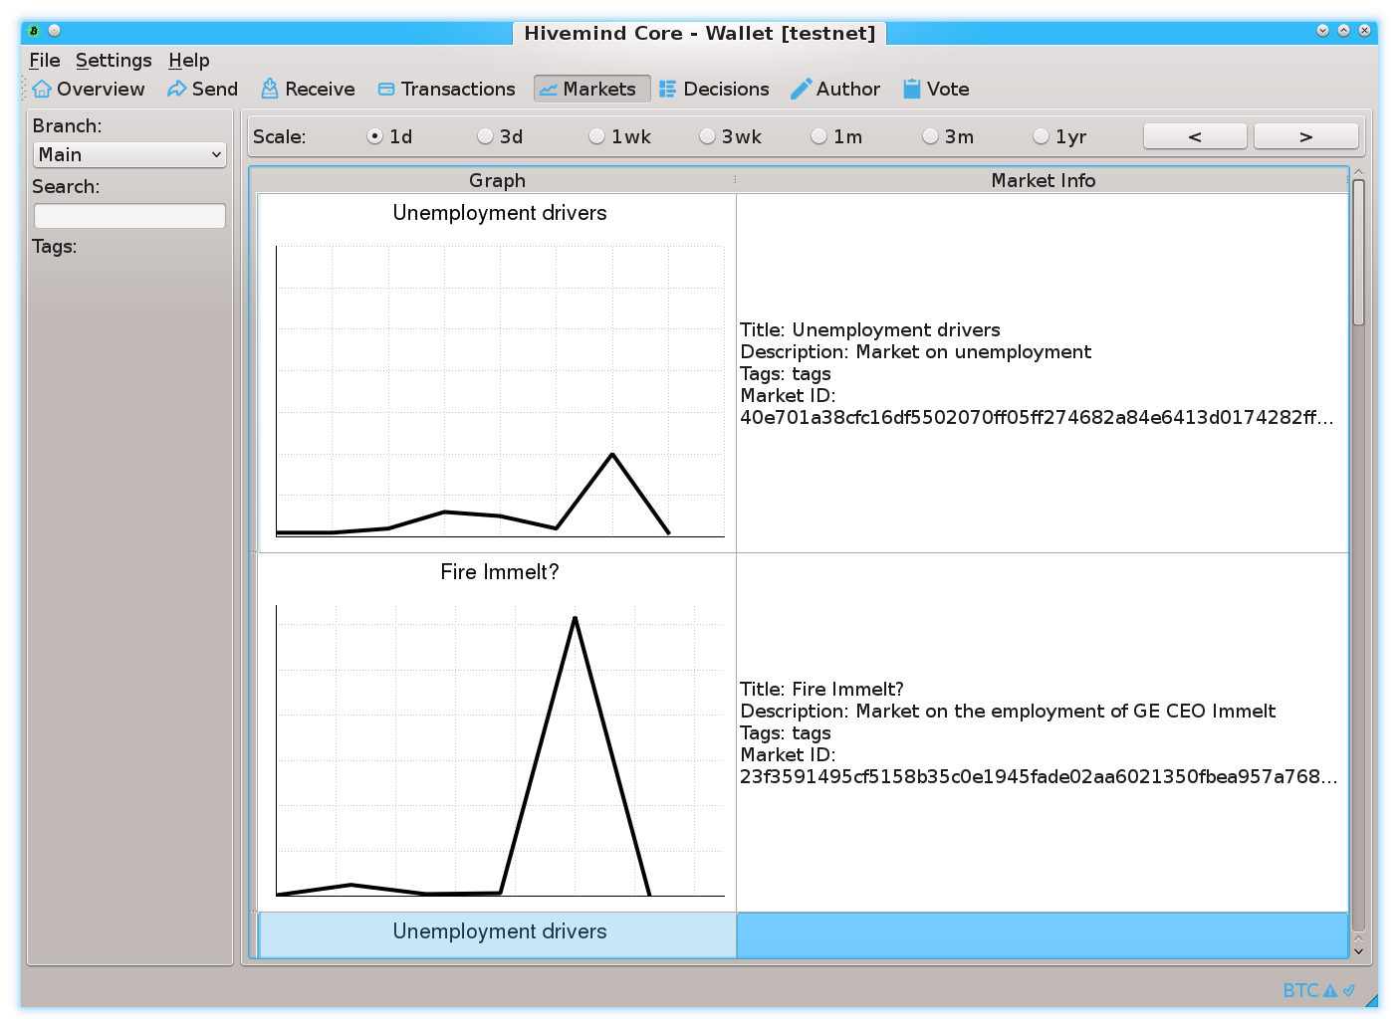
Prediction Markets
Screenshots from my own BTC sidechain project
www.BitcoinHivemind.com
Notes:
…

Slide 31
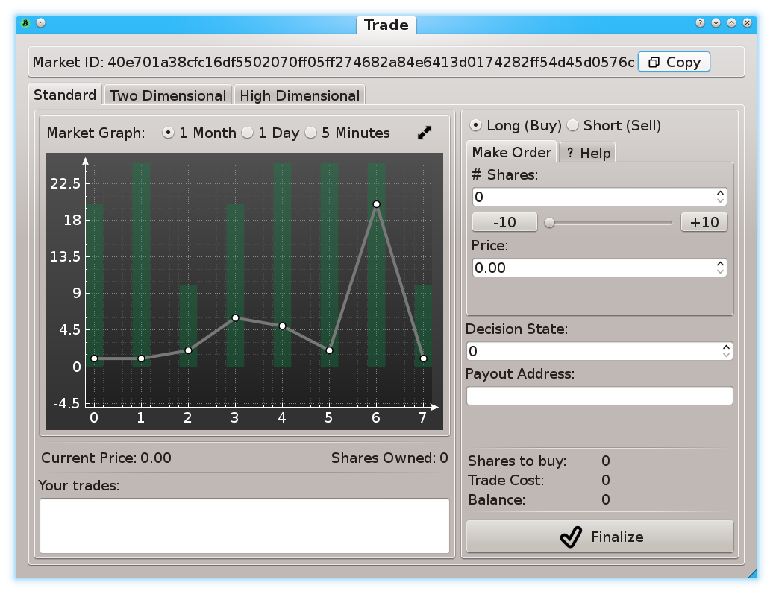
Prediction Markets
Screenshots from my own BTC sidechain project
www.BitcoinHivemind.com
Notes:
… This software can do a lot of things…

Slide 32
Prediction Markets
Screenshots from my own BTC sidechain project
www.BitcoinHivemind.com
Key Idea: “Futarchy” -- futures markets for how well certain leaders would perform, if they were in charge.
Notes:
…but the crowd favorite is ‘Futarchy’ – where there are futures markets for how well certain leaders would perform, if they were in charge. ... This idea is very distressing to bad leaders, [laugh] , because WE can learn about exactly how bad they are going to be, before we cast a vote for anyone. I think that this is one of the most important ideas in the whole world.

Slide 33

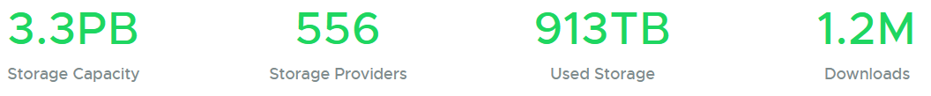
Altcoins we should copy (?): Sia
P2P Cloud Storage – Managed via Blockchain
Running for 5 years
No files ever lost?
$1-2 per TB/month (vs $23 on Amazon S3)
https://sia.tech
June 4
Notes:
This is Sia, which is David Vorick’s project (who some of you may know). (Decentralized P2P cloud storage, managed and enforced by the blockchain). So, you have a hard drive at home, a lot of that space you aren’t using. And you also have a bandwith connection at home, most of that bandwith you also aren’t using. With this you rent it out. Sia has been running for 5 years, it’s very decentralized – it would keep running if the dev team quit. He’s got the costs down an order of magnitude below Amazon. Using his Altcoin software – you can walk across a border, buy a new a blank computer, type in your 12 word seed phrase, and it will automatically download your entire filesystem (to that computer). It’s really kind of cool. Again, I gave this talk in June, 5 months ago. But I looked up the new numbers, yesterday…

Slide 34
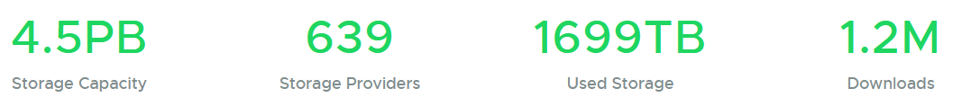
Altcoins we should copy (?): Sia
P2P Cloud Storage – Managed via Blockchain
Running for 5 years
No files ever lost?
$1-2 per TB/month (vs $23 on Amazon S3)
https://sia.tech
June 4
Nov 4 (Yesterday)
+36%
+15%
+86%
+0%
Notes:
…and here they are. They’re up a lot. Unfortunately, you don’t often hear about projects like this, because 99+% of Altcoins are scams, and it drowns out the useful projects. Which is sad. Yet another thing solved by Bip300, since no scammer would make a Bip300 sidechain.

Slide 35
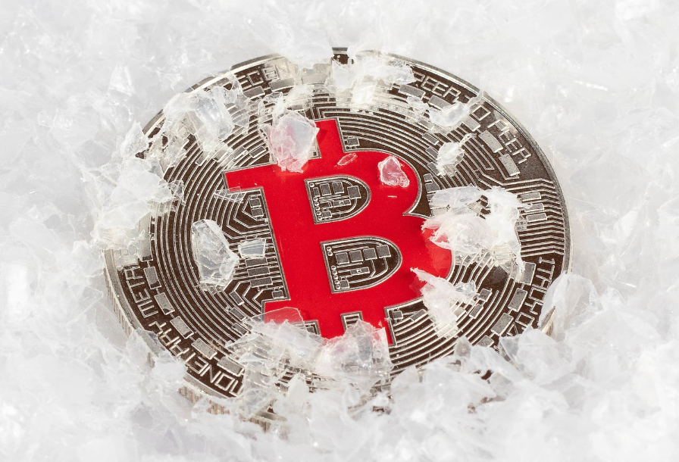
Finally: How Bip300 Improves Layer1
Never Change Layer 1 Again – “Protocol Ossification”
No “drama”.
No “mob rule”.
Shrink Layer1 Blocksize.
Improves Decentralization.
Protects your node.
“Frozen Bitcoin” - Marco Verch , Creative Commons License
Notes:
I will mention that, as an added bonus, if miners upgraded to activate Bips 300+301, then ---theoretically--- that might be the very last time anyone ever needs to upgrade their Bitcoin software again, ever. Which is more convenient, but also more secure as well. ( If you’re worrying about protecting Layer 1. ) Furthermore, in my opinion, Bip300 is the only practical way of eventually forking the Layer1 Blocksize down to 350k, which I know at least some of claim to want. Because this would improve decentralization (as recommended by some experts, including Luke Dashjr). …

Slide 36
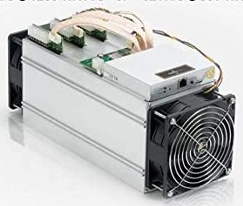
Two Supposed Drawbacks
(#1) Miners-Can-Steal from Bip300 Scripts (and this is bad)
Hashrate
fixed
cost
0%
100%
(#2) Merged-Mining is a Side-Hustle (and those are bad)
eb942ae710e951ed797e320b6c2fffc8d750423db8b1f2b0f1fc122b7affc889
eb94 ... Pays Out
e320b6c2fffc8d750423db8b1eb942ae710e951ed797f7affc8892b0f1fc122b
Notes:
… Ok now for those *drawbacks*. Here they are. The first supposed drawback of Bip300, is that miners can ---with a little bit of setup and technical knowledge and effort on their part, and certainly patience--- miners can remove all the coins from a Bip300 sidechain, and pay those coins, to themselves. Hence it is called the “miners- can-steal” problem. Here you see an evil miner, replacing that one hash I mentioned before with a different hash, and then it eventually pays out (to the miner). The second, supposed drawback of Bip300, *sigh* is: if some miners ever have a profitable side- hustle, then maybe some other miners might not be able to have that side hustle. And then they might go out of business; and wouldn’t be able to buy as many Xmas presents for their children.

Slide 37
(#1) Miners-Can-Steal from Bip300 Scripts (and this is bad) | (#2) Merged-Mining is a Side-Hustle (and those are always bad)
The free market allows entrepreneurs to go bankrupt – this is an essential part of creativity. True: not every SC will succeed. But those few that do, will pay fees to miners and boost BTC’s appeal (since BTC can now easily do everything). The failures will serve as a warning to lazy or incompetent developers. | The fixed cost in question… …is zero under BMM. …was already microscopic, vs other miner fixed costs. …must always be small enough for non-mining nodes to exist (since their revenue is the smallest of all, $0.)
Bip300 has multiple safeguards in place to make “stealing” difficult. Stealing requires 3-6 months of openly dishonest mining activity. Humans can audit theft, by checking just 32 bytes. | Mining is a complex task involving many “sub-tasks” (getting cheap power / sourcing good ASICs / etc). Each has its own incentives, innovation, and fixed costs. No stopping those.
Miners “can” steal from Lightning Network (by broadcasting old state + censoring Justice Txns), but this criterion is never held against LN. | Bizarre implications: if BitFury sold t-shirts on the side, for profit, then t-shirts = bad for BTC. If Saylor altruistically paid miners $0.10 per year, then MS = bad for Bitcoin.
The user is sovereign. Users are allowed to sell their BTC for USD; or use BTC to buy “bad” products (ie “drugs”). Or invest in Alts / scams. Bip300 allows users to spend BTC to a script. | MM is the opposite of bad – it is good and necessary. MM alone can boost BTC’s fee revenues by 10,000x or more. Without MM, long run hashrate may be too low.
This supposed “flaw” is actually a pro, as it gives miners motive and opportunity to destroy “parasite sidechains” (SC which antagonize other SCs). I am not aware of any other way of efficiently accomplishing this. And I believe it is prerequisite for high-quality smart contracts. | What is probably happening is that people are confusing node costs with mining costs. Node costs *must* be low, for decentralization. But mining costs have no such requirement. In fact, if we wanted mining costs to be low we could remove the upward difficulty adjustments.
The whole point of SCs is that Layer1 nodes ignore them. With federations, you trust a fixed committee of law-abiding people. With BIp300 you trust a decentralized P2P process. | MM is already unblockable. Satoshi invented MM in 2010, and envisioned many independent MM chains. We have been MM since 2011, with no end in sight.
Notes:
Both of these are so, false, that its hard to know where to begin.

Slide 38
(#1) Miners-Can-Steal from Bip300 Scripts (and this is bad) | (#2) Merged-Mining is a Side-Hustle (and those are always bad)
The free market allows entrepreneurs to go bankrupt – this is an essential part of creativity. True: not every SC will succeed. But those few that do, will pay fees to miners and boost BTC’s appeal (since BTC can now easily do everything). The failures will serve as a warning to lazy or incompetent developers. | The fixed cost in question… …is zero under BMM. …was already microscopic, vs other miner fixed costs. …must always be small enough for non-mining nodes to exist (since their revenue is the smallest of all, $0.)
Bip300 has multiple safeguards in place to make “stealing” difficult. Stealing requires 3-6 months of openly dishonest mining activity. Humans can audit theft, by checking just 32 bytes. | Mining is a complex task involving many “sub-tasks” (getting cheap power / sourcing good ASICs / etc). Each has its own incentives, innovation, and fixed costs. No stopping those.
Miners “can” steal from Lightning Network (by broadcasting old state + censoring Justice Txns), but this criterion is never held against LN. | Bizarre implications: if BitFury sold t-shirts on the side, for profit, then t-shirts = bad for BTC. If Saylor altruistically paid miners $0.10 per year, then MS = bad for Bitcoin.
The user is sovereign. Users are allowed to sell their BTC for USD; or use BTC to buy “bad” products (ie “drugs”). Or invest in Alts / scams. Bip300 allows users to spend BTC to a script. | MM is the opposite of bad – it is good and necessary. MM alone can boost BTC’s fee revenues by 10,000x or more. Without MM, long run hashrate may be too low.
This supposed “flaw” is actually a pro, as it gives miners motive and opportunity to destroy “parasite sidechains” (SC which antagonize other SCs). I am not aware of any other way of efficiently accomplishing this. And I believe it is prerequisite for high-quality smart contracts. | What is probably happening is that people are confusing node costs with mining costs. Node costs *must* be low, for decentralization. But mining costs have no such requirement. In fact, if we wanted mining costs to be low we could remove the upward difficulty adjustments.
The whole point of SCs is that Layer1 nodes ignore them. With federations, you trust a fixed committee of law-abiding people. With BIp300 you trust a decentralized P2P process. | MM is already unblockable. Satoshi invented MM in 2010, and envisioned many independent MM chains. We have been MM since 2011, with no end in sight.
c
Notes:
So, Bip300 is designed, to prevent miners from stealing from sidechains. But, it is nonetheless possible. Similarly, – miners “can” (can in quotes **) steal from the LN. In fact its much easier for miners to steal from the LN, since Bip300 has this 6 month timeout period. So, were you worried about miners stealing from the lightning network a moment ago? If so, just cross off this entire left half of the page. I have to stress: this comparison isn’t to knock the LN, I’m saying that the criterion is stupid. 51% hashrate can do a lot of horrible things, but that doesn’t stop us from allowing users to opt-in to certain tradeoffs. After all, its Bitcoin not Prison.

Slide 39
(#1) Miners-Can-Steal from Bip300 Scripts (and this is bad) | (#2) Merged-Mining is a Side-Hustle (and those are always bad)
The free market allows entrepreneurs to go bankrupt – this is an essential part of creativity. True: not every SC will succeed. But those few that do, will pay fees to miners and boost BTC’s appeal (since BTC can now easily do everything). The failures will serve as a warning to lazy or incompetent developers. | The fixed cost in question… …is zero under BMM. …was already microscopic, vs other miner fixed costs. …must always be small enough for non-mining nodes to exist (since their revenue is the smallest of all, $0.)
Bip300 has multiple safeguards in place to make “stealing” difficult. Stealing requires 3-6 months of openly dishonest mining activity. Humans can audit theft, by checking just 32 bytes. | Mining is a complex task involving many “sub-tasks” (getting cheap power / sourcing good ASICs / etc). Each has its own incentives, innovation, and fixed costs. No stopping those.
Miners “can” steal from Lightning Network (by broadcasting old state + censoring Justice Txns), but this criterion is never held against LN. | Bizarre implications: if BitFury sold t-shirts on the side, for profit, then t-shirts = bad for BTC. If Saylor altruistically paid miners $0.10 per year, then MS = bad for Bitcoin.
The user is sovereign. Users are allowed to sell their BTC for USD; or use BTC to buy “bad” products (ie “drugs”). Or invest in Alts / scams. Bip300 allows users to spend BTC to a script. | MM is the opposite of bad – it is good and necessary. MM alone can boost BTC’s fee revenues by 10,000x or more. Without MM, long run hashrate may be too low.
This supposed “flaw” is actually a pro, as it gives miners motive and opportunity to destroy “parasite sidechains” (SC which antagonize other SCs). I am not aware of any other way of efficiently accomplishing this. And I believe it is prerequisite for high-quality smart contracts. | What is probably happening is that people are confusing node costs with mining costs. Node costs *must* be low, for decentralization. But mining costs have no such requirement. In fact, if we wanted mining costs to be low we could remove the upward difficulty adjustments.
The whole point of SCs is that Layer1 nodes ignore them. With federations, you trust a fixed committee of law-abiding people. With BIp300 you trust a decentralized P2P process. | MM is already unblockable. Satoshi invented MM in 2010, and envisioned many independent MM chains. We have been MM since 2011, with no end in sight.
Notes:
The second one is even sillier. I think what I would like to highlight is that the implications are ridiculous. So, if BitFury sold t-shirts on the side, for profit, then t-shirts = bad for BTC. They would be as bad for Bitcoin as Bip300 is, anyway. If Michal Saylor altruistically paid miners $0.10 per year, then MS = bad for 9 Bitcoin. Blah blah blah... I think what’s really happening here, is that people are confusing nodes with miners. Miners run nodes, but not the other way around. We want nodes to be as cheap as possible. That is absolutely important; but we don’t want mining to be as cheap as possible. If we wanted that, we could just get rid of all of the upward difficulty adjustments. So I have total contempt for these two supposed drawbacks. In fact both of them are not drawbacks at all…

Slide 40
(#1) Miners-Can-Steal from Bip300 Scripts (and this is bad) | (#2) Merged-Mining is a Side-Hustle (and those are always bad)
The free market allows entrepreneurs to go bankrupt – this is an essential part of creativity. True: not every SC will succeed. But those few that do, will pay fees to miners and boost BTC’s appeal (since BTC can now easily do everything). The failures will serve as a warning to lazy or incompetent developers. | The fixed cost in question… …is zero under BMM. …was already microscopic, vs other miner fixed costs. …must always be small enough for non-mining nodes to exist (since their revenue is the smallest of all, $0.)
Bip300 has multiple safeguards in place to make “stealing” difficult. Stealing requires 3-6 months of openly dishonest mining activity. Humans can audit theft, by checking just 32 bytes. | Mining is a complex task involving many “sub-tasks” (getting cheap power / sourcing good ASICs / etc). Each has its own incentives, innovation, and fixed costs. No stopping those.
Miners “can” steal from Lightning Network (by broadcasting old state + censoring Justice Txns), but this criterion is never held against LN. | Bizarre implications: if BitFury sold t-shirts on the side, for profit, then t-shirts = bad for BTC. If Saylor altruistically paid miners $0.10 per year, then MS = bad for Bitcoin.
The user is sovereign. Users are allowed to sell their BTC for USD; or use BTC to buy “bad” products (ie “drugs”). Or invest in Alts / scams. Bip300 allows users to spend BTC to a script. | MM is the opposite of bad – it is good and necessary. MM alone can boost BTC’s fee revenues by 10,000x or more. Without MM, long run hashrate may be too low.
This supposed “flaw” is actually a pro, as it gives miners motive and opportunity to destroy “parasite sidechains” (SC which antagonize other SCs). I am not aware of any other way of efficiently accomplishing this. And I believe it is prerequisite for high-quality smart contracts. | What is probably happening is that people are confusing node costs with mining costs. Node costs *must* be low, for decentralization. But mining costs have no such requirement. In fact, if we wanted mining costs to be low we could remove the upward difficulty adjustments.
The whole point of SCs is that Layer1 nodes ignore them. With federations, you trust a fixed committee of law-abiding people. With BIp300 you trust a decentralized P2P process. | MM is already unblockable. Satoshi invented MM in 2010, and envisioned many independent MM chains. We have been MM since 2011, with no end in sight.
Notes:
… the left one allows for super-reliable oracle and high-quality smart contracts, and the right one is the only thing that is going to keep hashrate security up, in the future. So, they’re not drawbacks at all, in fact they’re both pretty cool; features.

Slide 41
Future of Bip300 – Depends on You!
Learn !
Download the software
Read drivechain.info
Talk
Soft forks need consensus
Invite on podcasts/whatever
View Altcoins Differently
drivechain.info/releases/
Drivechain = Bip 300+301
Talk
Learn
Notes:
Ok, what should you do? Here is what I suggest: The most important thing is, to learn. The best way to learn, is to actually download the software and use it. Don’t listen to what people say on Twitter. Run the testnet software yourself ... otherwise you know ... nothing. Second: the Bitcoin community prides itself on consensus – we don’t make a change, until lots of people agree that they want it. So: help spread the word. So, talk to your friends or whatever. Finally, maybe (?) this might help – Change the way you view Altcoins. They aren’t rivals, that are inherently evil; they’re a place where technology is previewed, before it is copied into BTC.

Slide 42
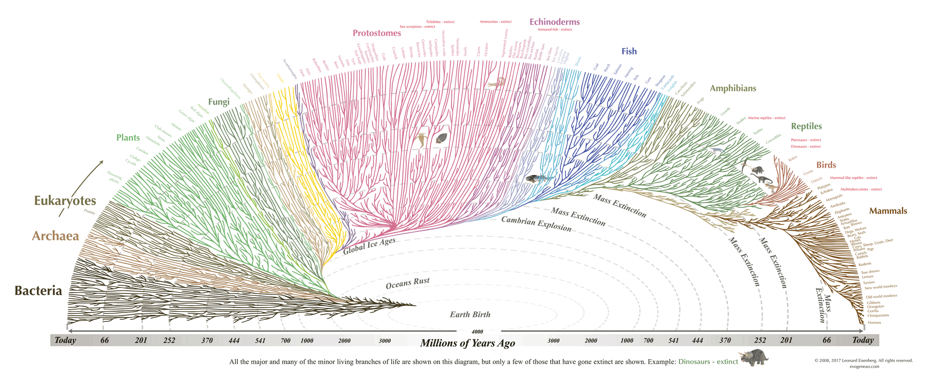
Thank You for Your Attention! (Find me and talk to me!)
Notes:
Ok that’s the talk, thank you! : )

